Slide 1
Automatic Colorization of Grayscale Images with Auto-Encoders
Rahul D Shetty
Sudarshan Baliga B

Slide 2
Recap on Image Colorization
Coloring Grayscale images.
Resolution: 64x64
ResNet Model

Slide 3
U-Net Architecture
Initially used for Image Segmentation
Auto-Encoder Structure
Skip Through Connections
Fully Convolutional Network

Slide 4
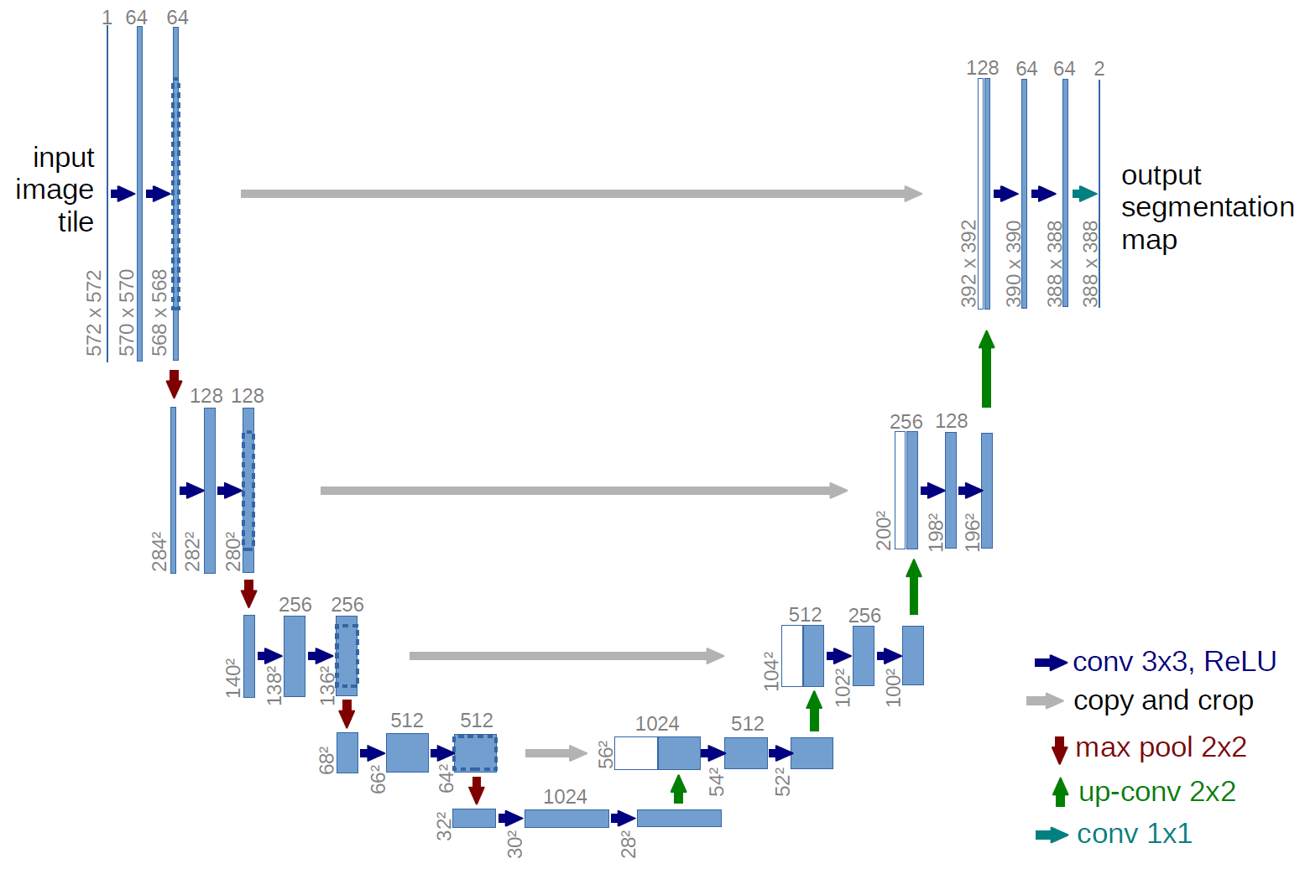

Slide 5
Higher Resolution Images
Rescale down images to 224x224
Apply Colorization
Scale to the original size by using bicubic Interpolation.
Replace the L component of image.

Slide 6

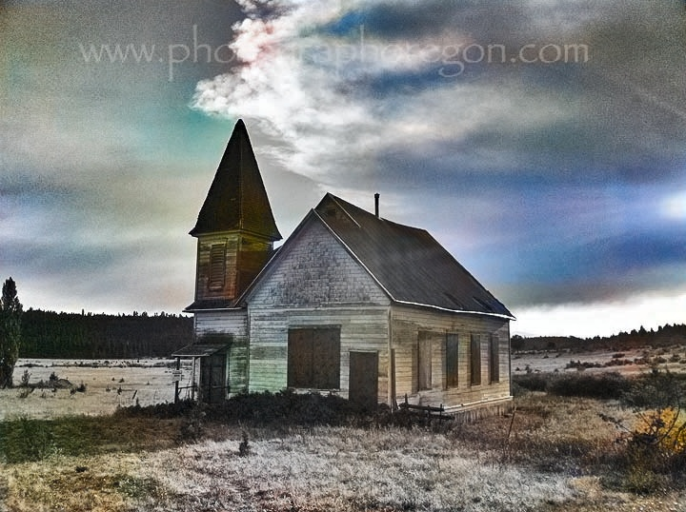
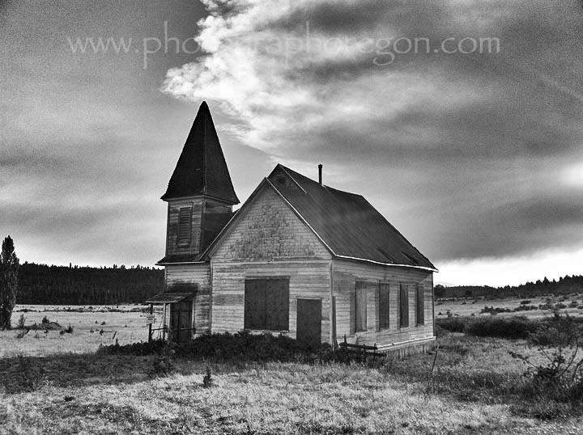
Higher Resolution Images
Change L component of LAB
Image Original Size
Image 224x224x1
Colorizer
Image 224x224x3
Image Original Size

Slide 7
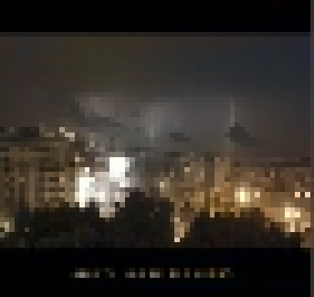
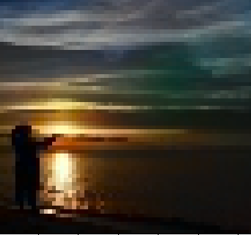
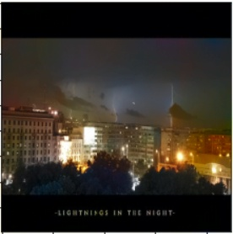
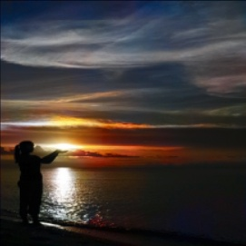
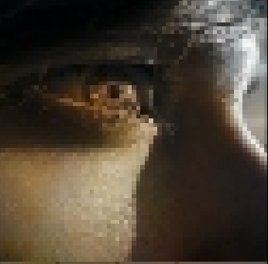
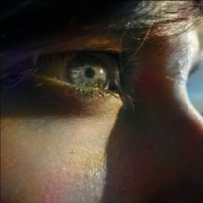
Results
Before
After

Slide 8
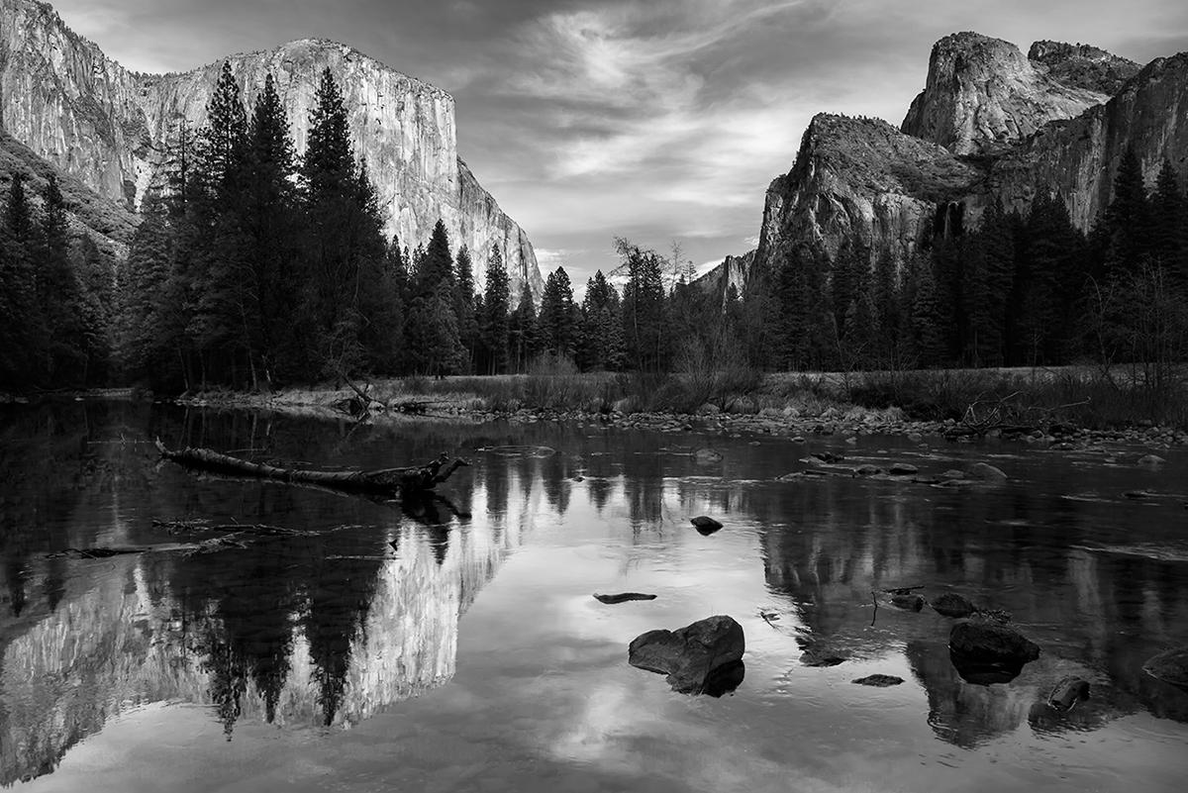
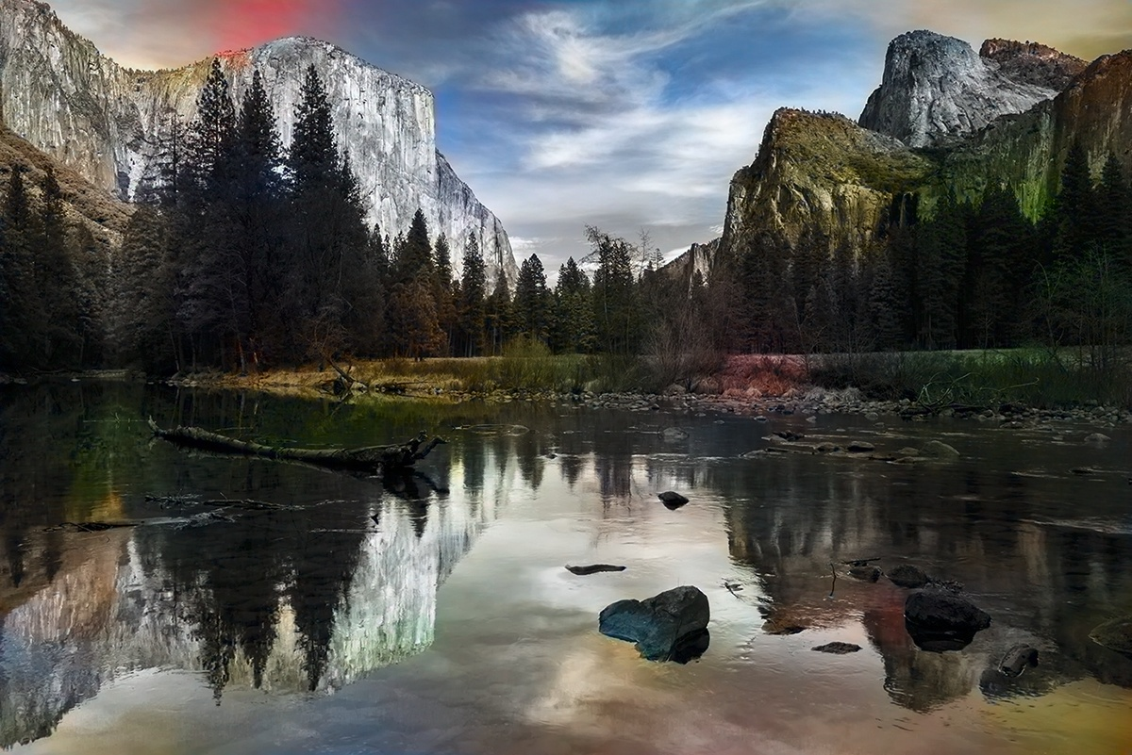
Results

Slide 9
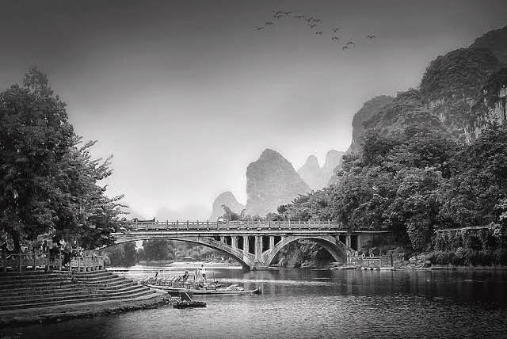
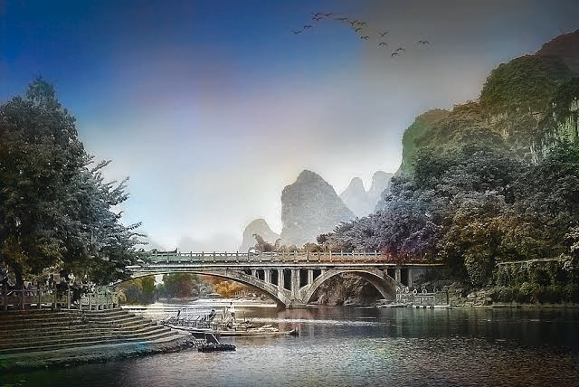
Results

Slide 10
DEMO

Slide 11
Conclusion and Future Work
A Simple GUI Application
Different Architecture
Pre-trained features
Training on Larger Dataset
Video Colorization

Slide 12
Thank You

